Slide 1

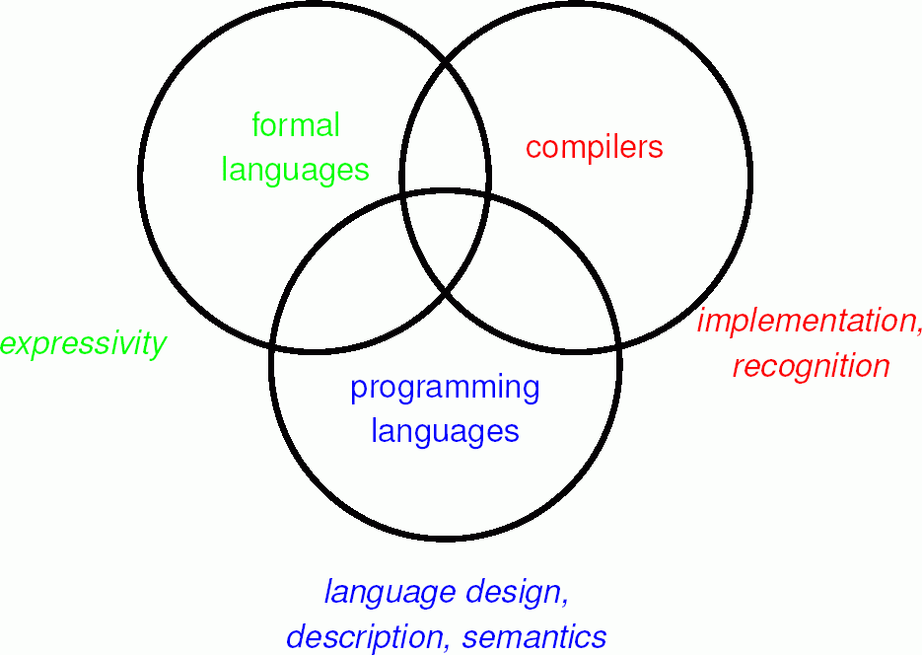


Formal Languages

Slide 2

Formal Language
What is a language?
A language is a collection of sentences
A sentence is a sequence of word
A word is a combination of syllables
A formal learning of language has the following three steps:
Learning its alphabets
Its words
Formation of sentences
3

Slide 3
Alphabets and Strings
Alphabet is a non empty finite set
String over an alphabet Σ is a finite sequence of symbols of Σ.
String is also known as word or sentence
3

Slide 4
Alphabets and Strings
We use a ε, to denote an empty string
The set of all strings over an alphabet Σ is denoted by Σ*
3

Slide 5
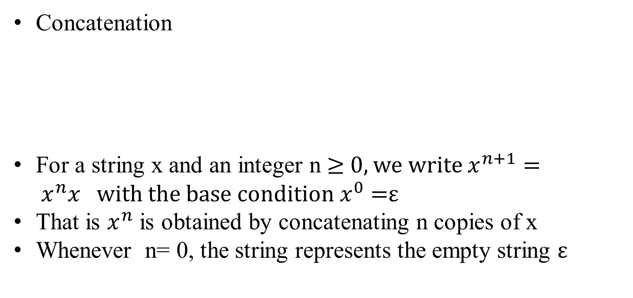
String Manipulation
Concatenation
For a string x and an integer n ≥ 0, we write $x^{n+1}= x^{n}x with the base condition x^{0}=$ε
That is $x^{n}$ is obtained by concatenating n copies of x
Whenever n= 0, the string represents the empty string ε
3

Slide 6
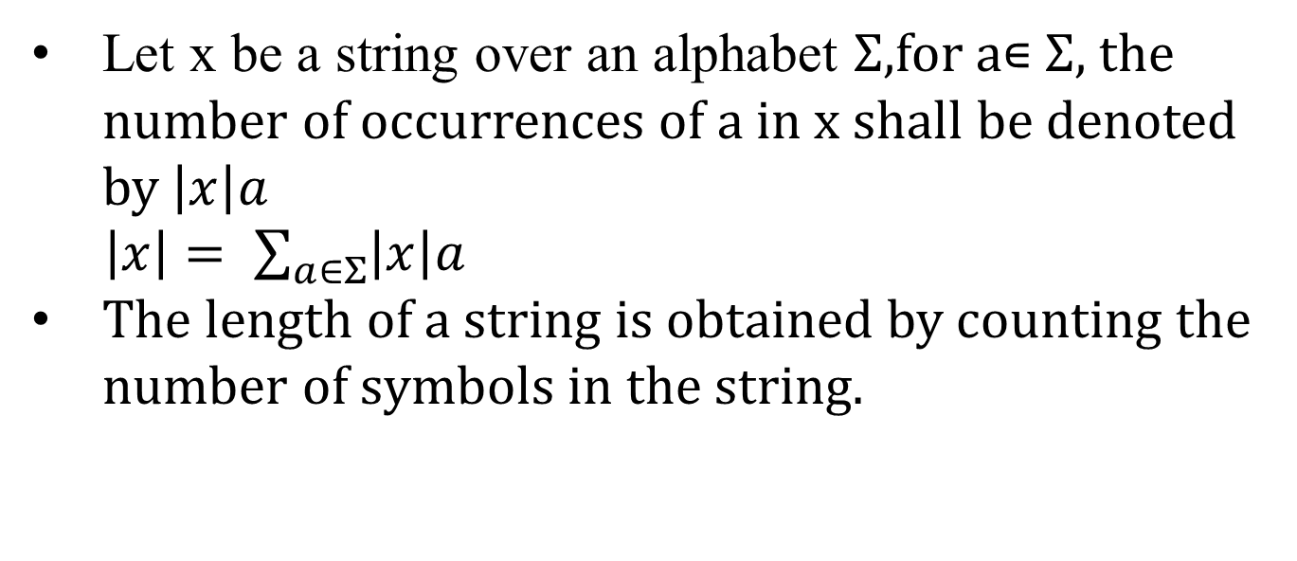
String Manipulation
Let x be a string over an alphabet Σ,for a∊ Σ, the number of occurrences of a in x shall be denoted by $\left|x\right|a$
$\left|x\right|= \sum_{a∈Σ}{\left|x\right|a}$
The length of a string is obtained by counting the number of symbols in the string.
3

Slide 7
String Manipulation
If we denote An to be the set of all strings of length n over Σ, then one can easily observe
Σ* = ⋃ An
n>0
x is a substring of y if x occurs in y, that is
3

Slide 8
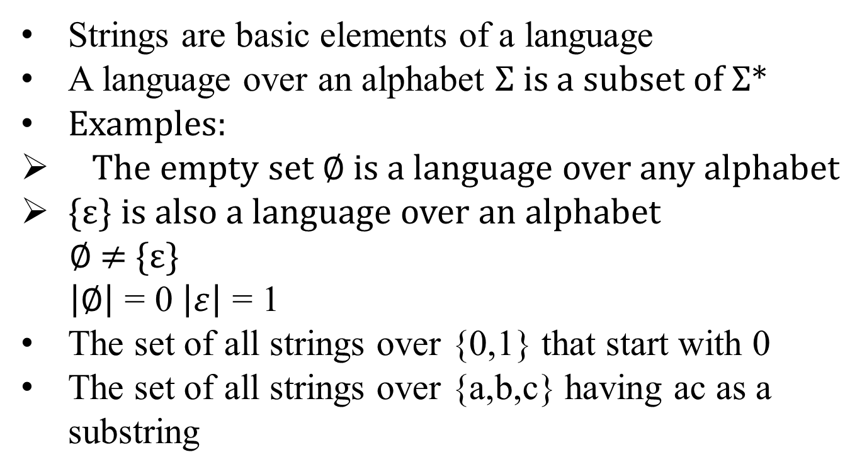
Languages
Strings are basic elements of a language
A language over an alphabet Σ is a subset of Σ*
Examples:
The empty set ∅ is a language over any alphabet
{ε} is also a language over an alphabet
∅ ≠ {ε}
$\left|∅\right|$ = 0 $\left|ε\right|$ = 1
The set of all strings over {0,1} that start with 0
The set of all strings over {a,b,c} having ac as a substring
3

Slide 9
Set
A set is a well defined collection of objects and it is denoted by :
Enumerating the number within { and }
2. Using a set builder notation
3

Slide 10
Set Operations
Union
Intersection
Set-difference
Cartesian product
3

Slide 11
Set Operations
Power set
2. Concatenation
3. Closure
3

Slide 12
Kleene star or closure of language L
3

